Slide 1

Notes:
Home Page

Slide 2
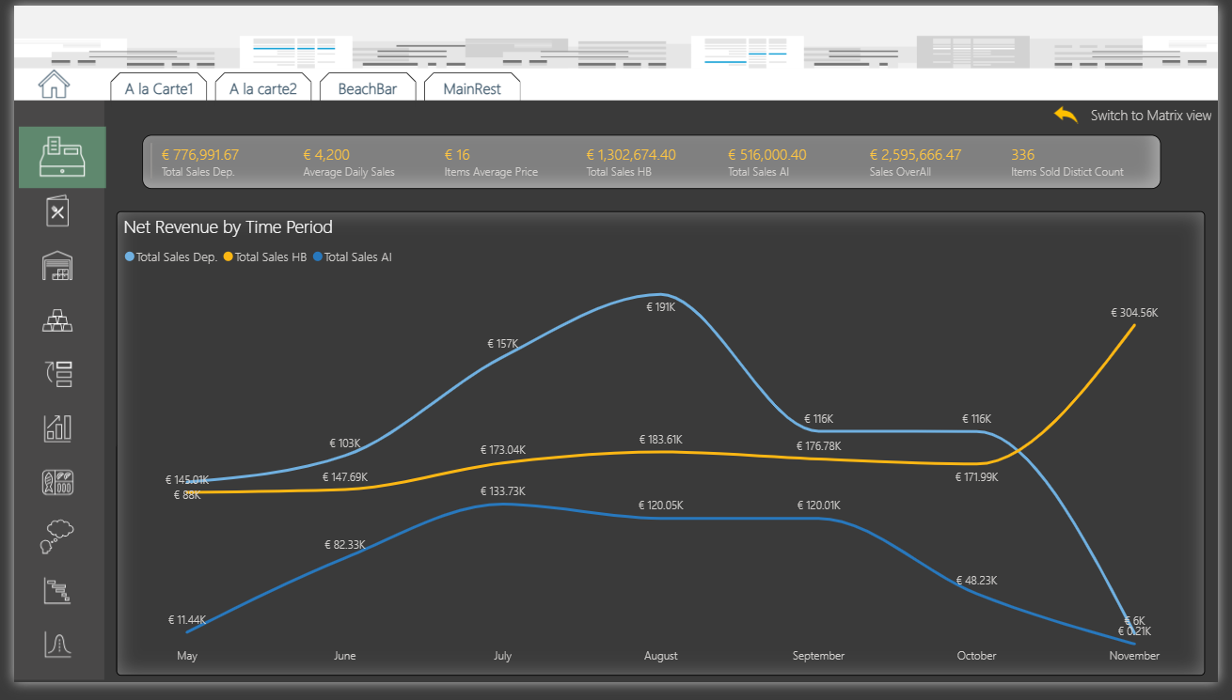
Notes:
Sales Overview

Slide 3
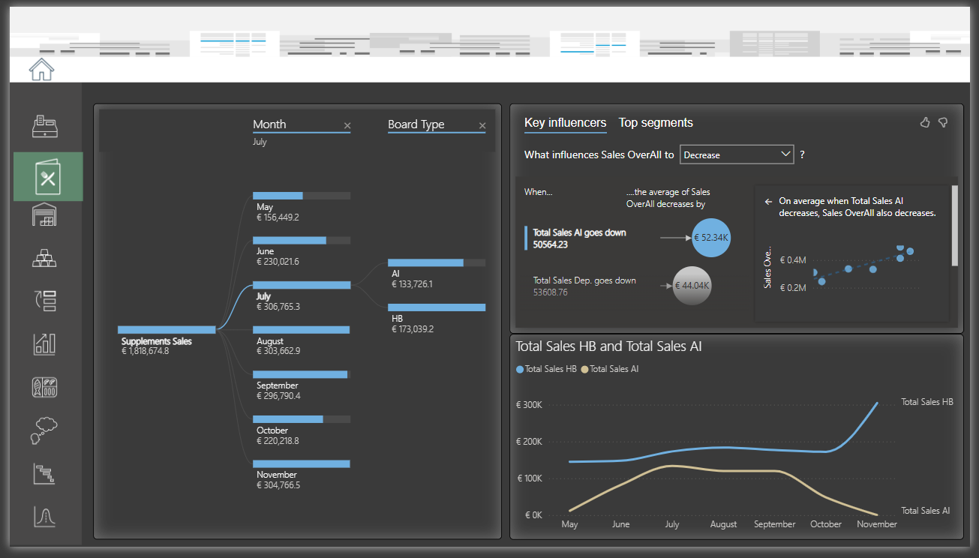
Notes:
Board Type ( Half Board / All Inclusive )

Slide 4
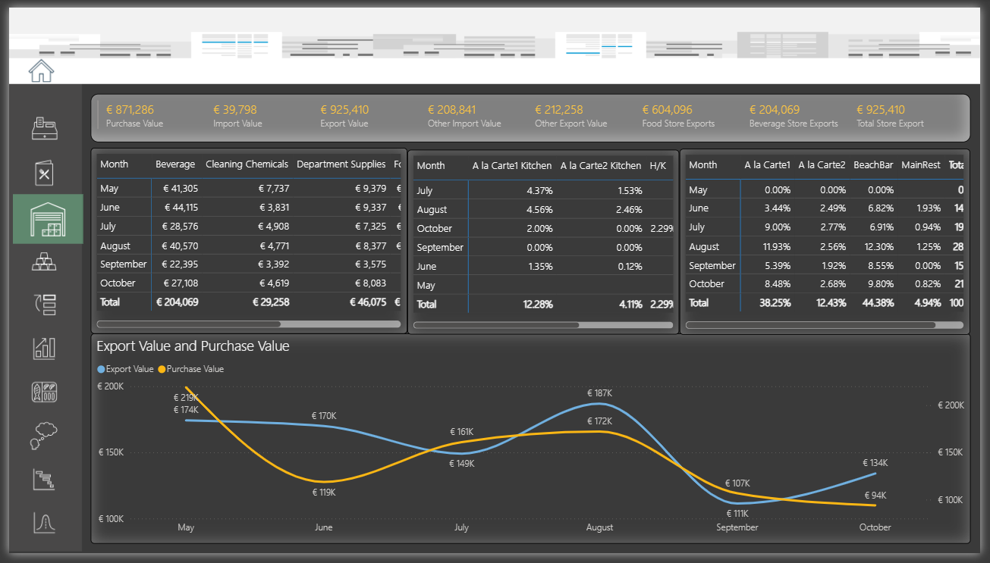
Notes:
Warehouse

Slide 5
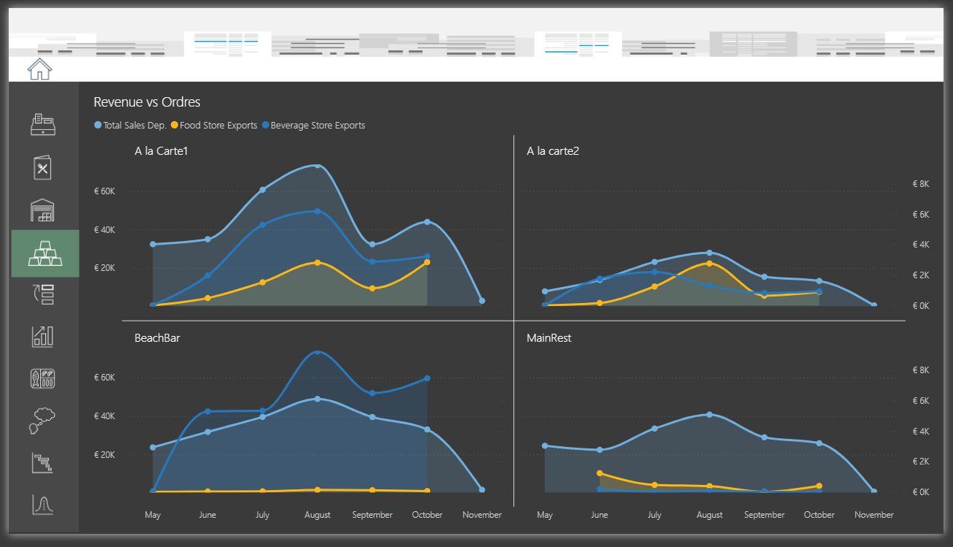
Notes:
Dep. Revenue vs Orders ( Imports from Warehouse )

Slide 6
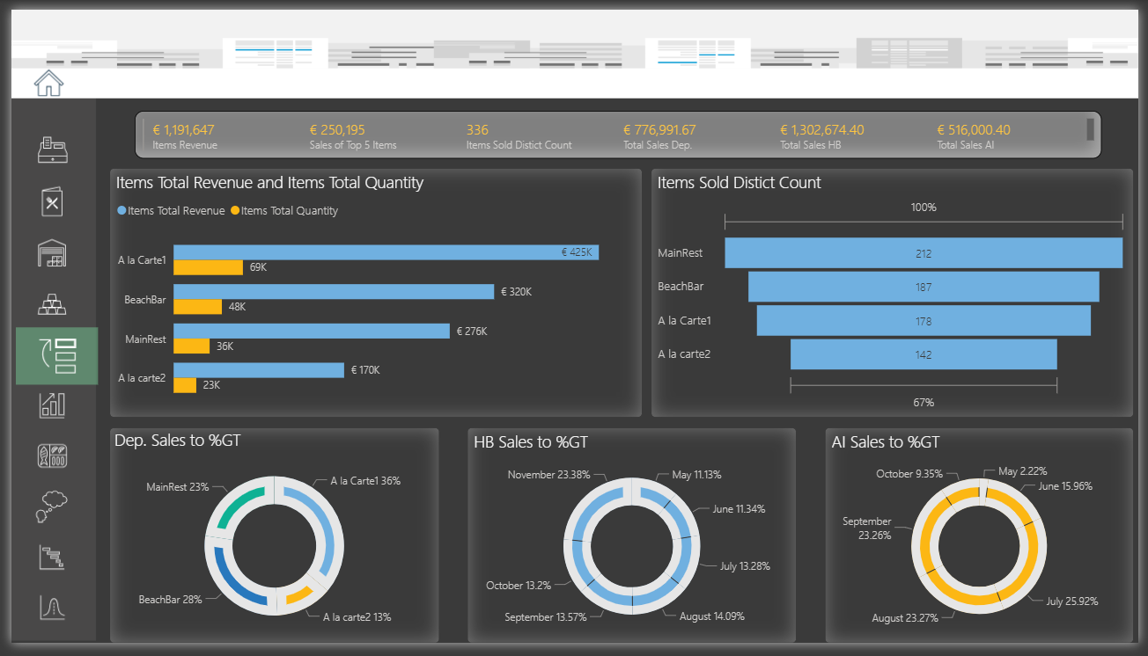
Notes:
% & Top N

Slide 7
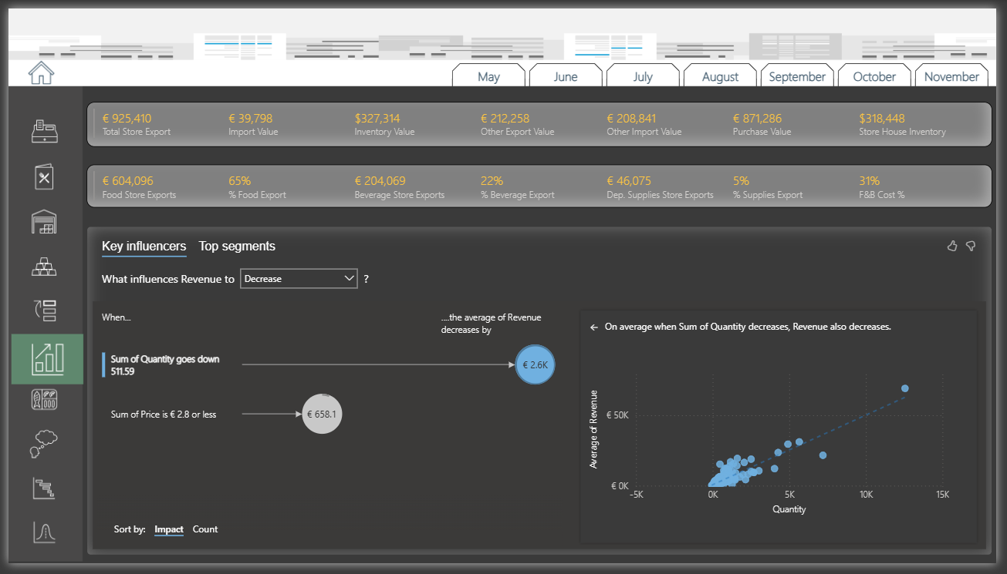
Notes:
KPI’s

Slide 8
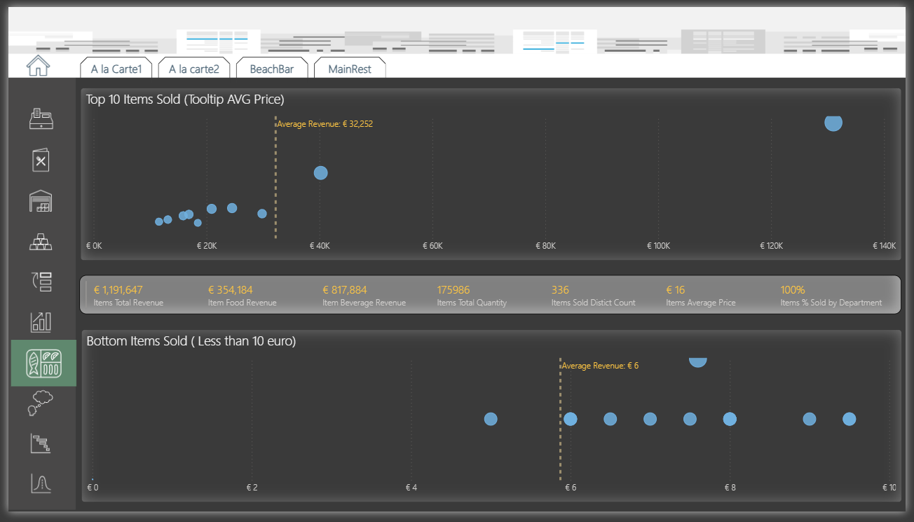
Notes:
Items Sold

Slide 9
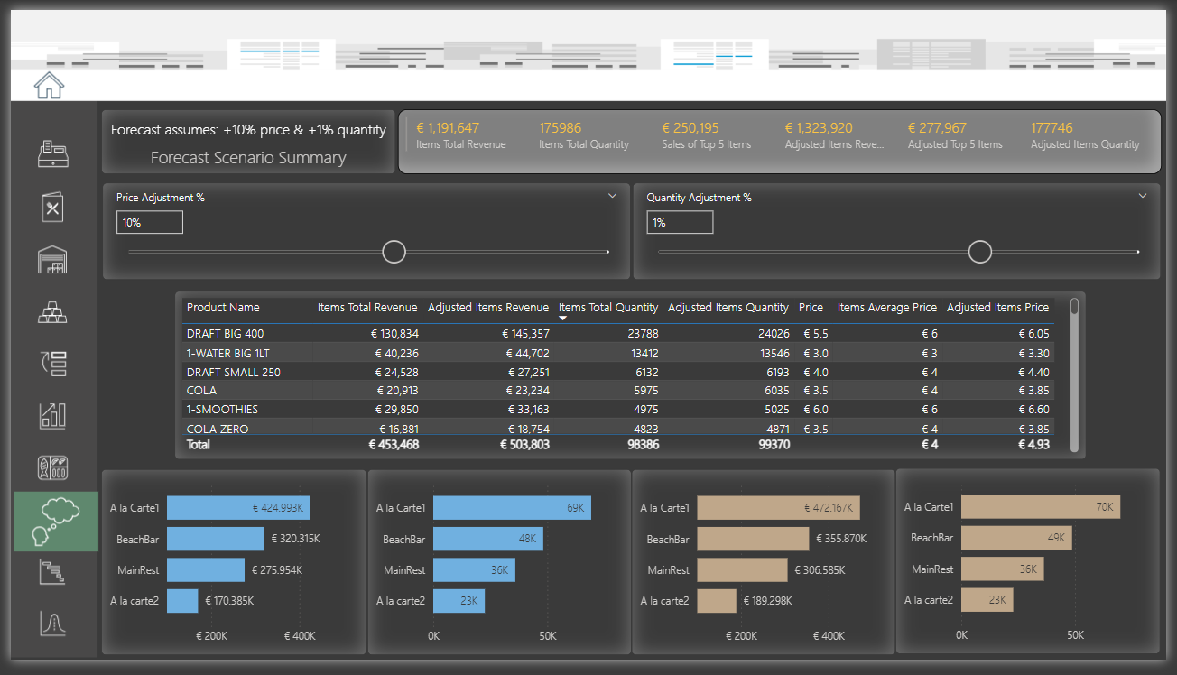
Notes:
Playground ( menu engineering )

Slide 10
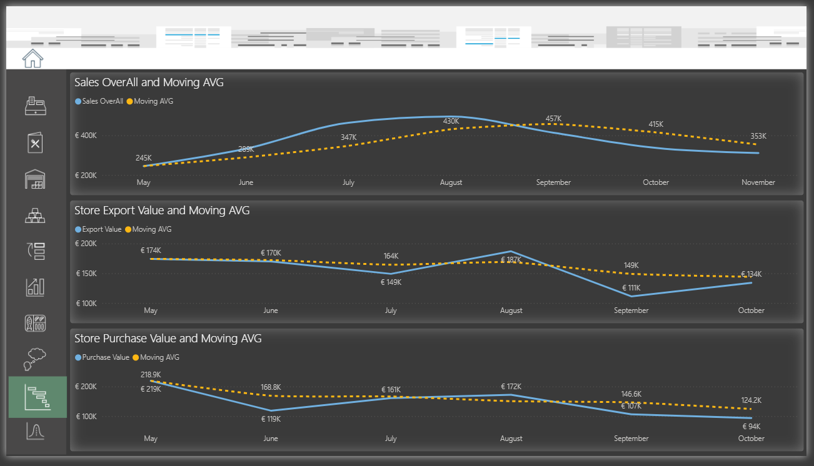
Notes:
Moving AVG

Slide 11
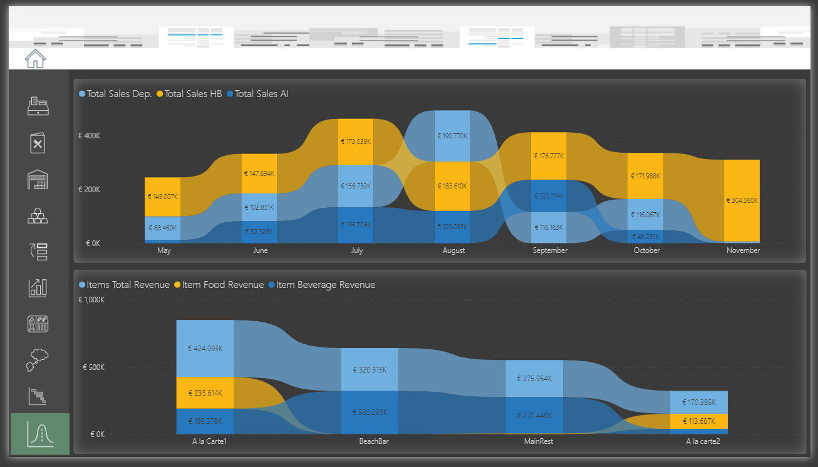
Notes:
Revenue Comparison

